Slide 1
Note for the honourable teachers:
This slide is hidden.
Please start with F5 to keep it hide.
The subject teachers are requested to read the notes given below the slides.
Notes are given for the honourable teachers below the slides no. 2, 7, 8, 10, 11, 12, 13, 14, 15, 16 and 17 .

Slide 2
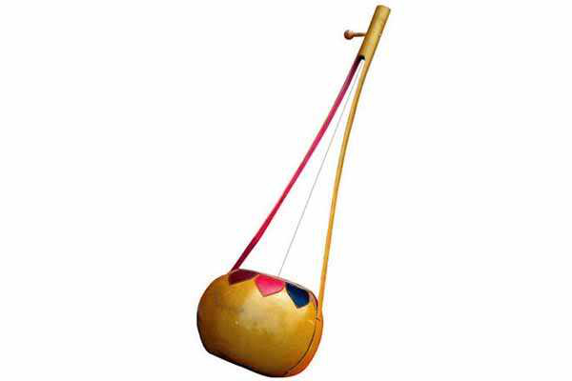
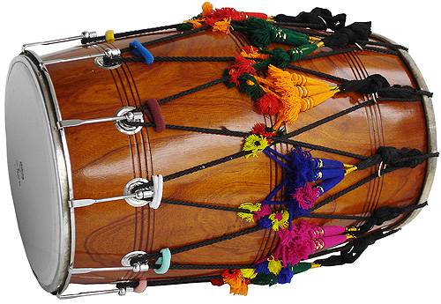
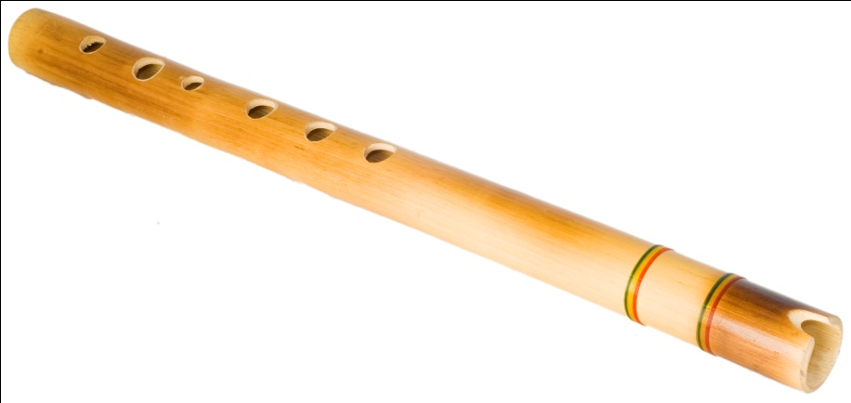
Welcome
Notes:
This pictures are related to the topic “ I like folk song”. These instruments are related to folk song. These are tabla, flute, and dotara.

Slide 3

INTRODUCTION
ROUFUN NAHAR
ASSISTANT TEACHER ( ENGLISH)
MAZIDA GOVT. HIGH SCHOOL
TONGI, GAZIPUR
CLASS: SEVEN
SUBJECT: ENGLISH FIRST PAPER

Slide 4

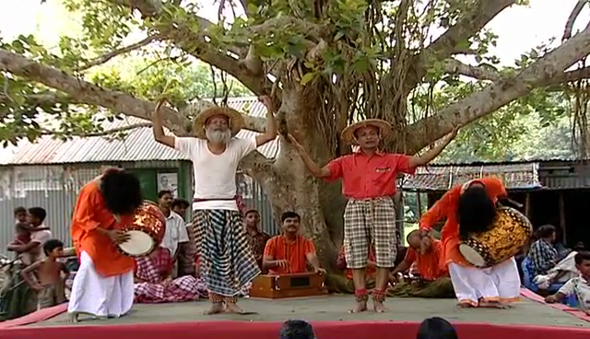
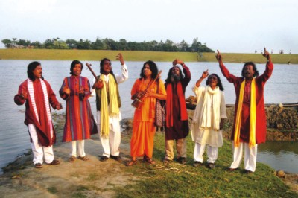
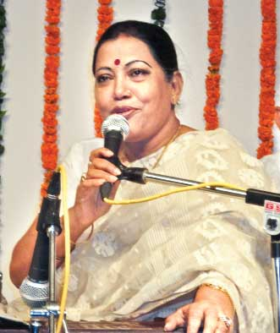
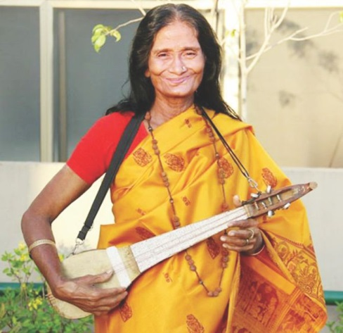
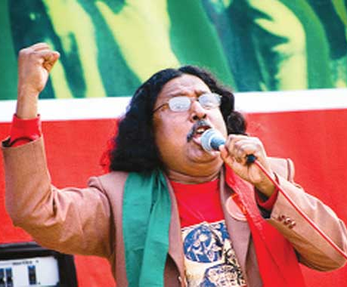
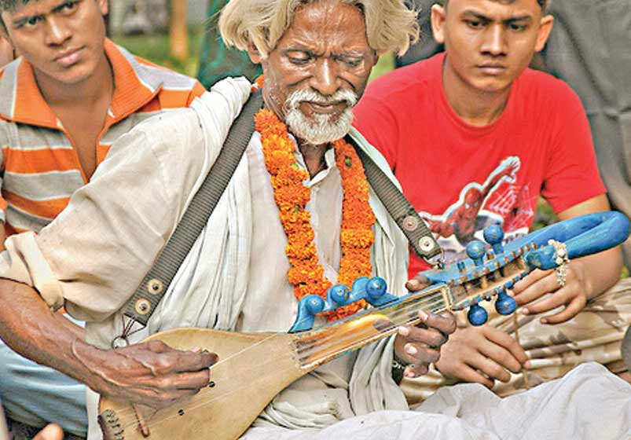
What type of songs do they sing?
Ans
Folk songs

Slide 5
Today our topic
I like folk songs
Unit: Eight, Lesson: One

Slide 6
LEARNING OUTCOMES OF THE LESSON
By the end of the lesson the students will be able to
Ask and answer questions about likes/dislikes.
Read and understand text.
Act out a dialogue.
Make questions about likes/dislikes.
Tell the meaning of some key words from inference.

Slide 7
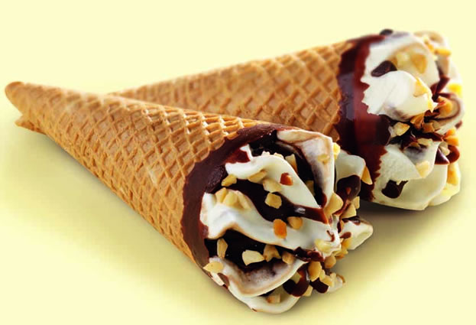
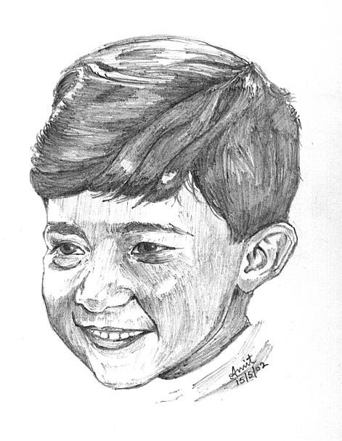
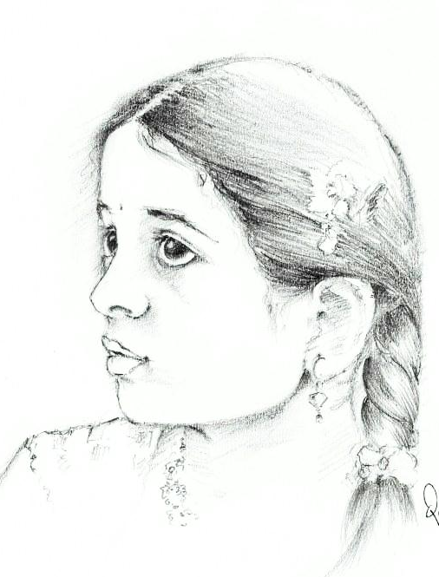
Listen their conversation about their likes and dislikes.
I like ice-cream. And you?
I like ice-cream too.
Notes:
The teacher can let the students listen the dialogue.

Slide 8
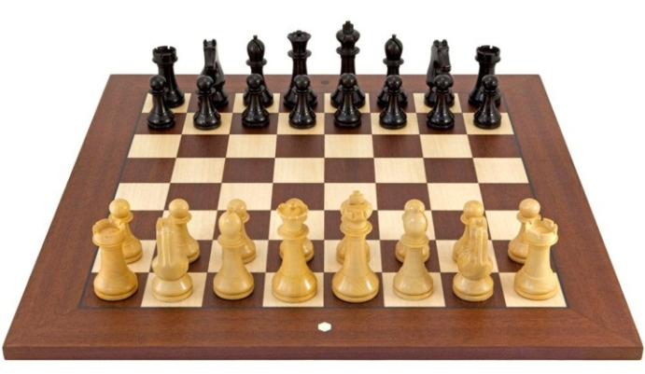
I like playing chess. And you?
I don’t like playing chess.
Notes:
The teacher can let the students listen the dialogue.

Slide 9
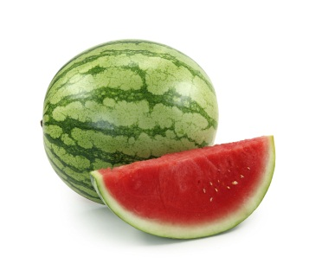
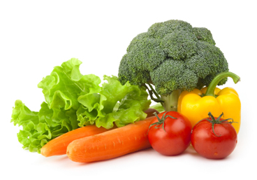
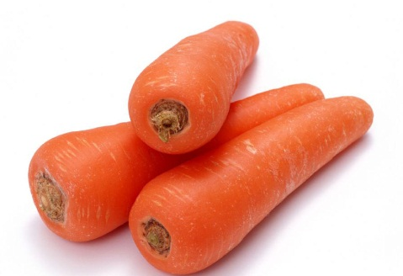
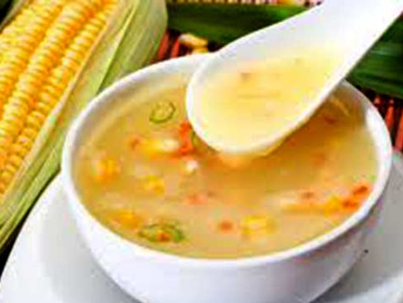
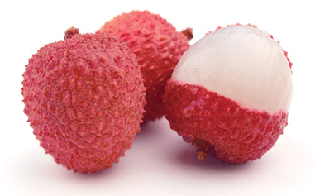
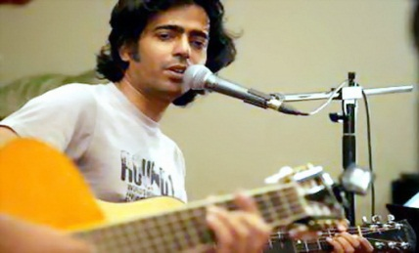
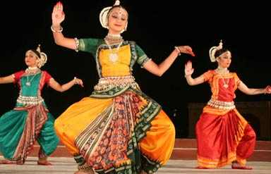
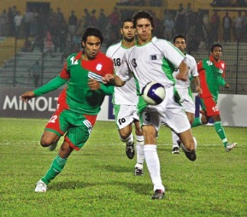
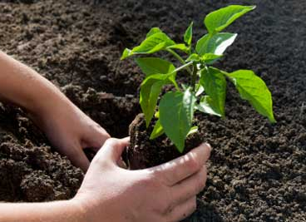
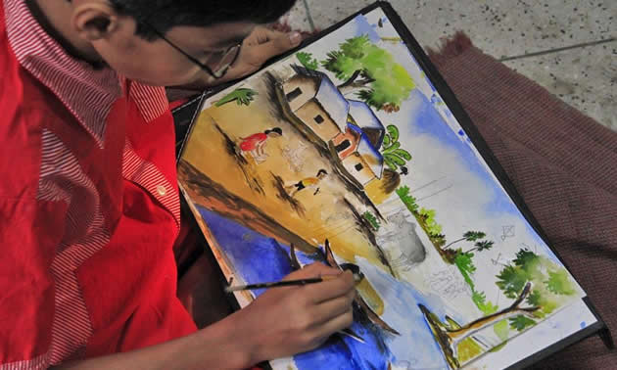
I like ice-cream. And you?
I like playing chess. And you?
I like ice-cream too.
I don’t like playing chess.
Look at the pictures. Which things and activities do you like? Using the above structures ask and answer in pairs.

Slide 10
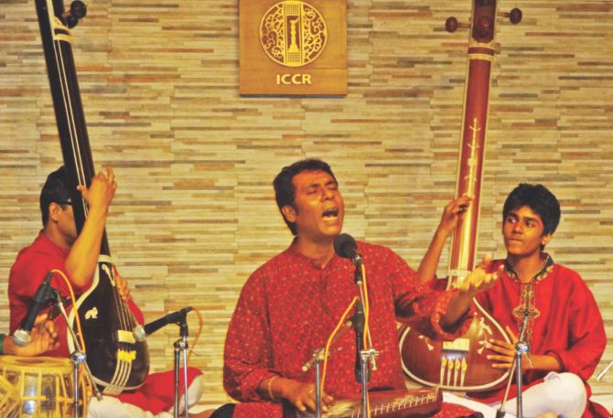
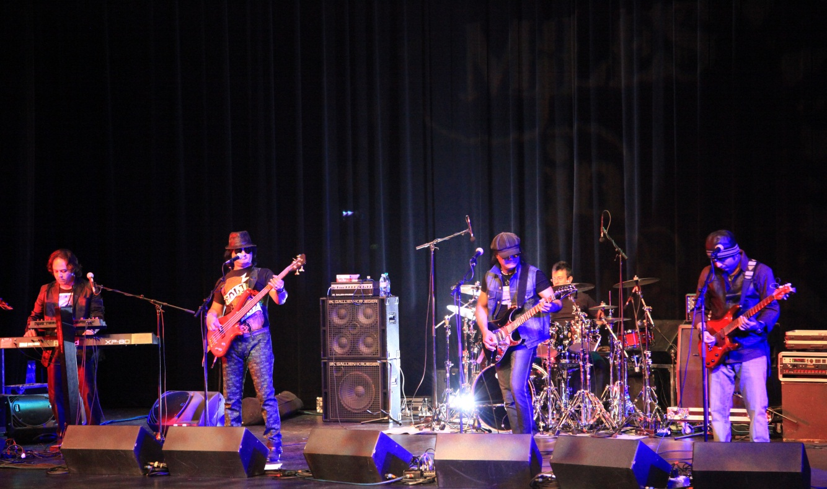
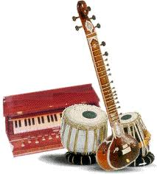
Vocabulary
Serious or conventional music following long-established principles rather than a folk, jazz, or popular tradition.
a type of music, usually played on electronic instruments. Pop music is often simply called pop.
Pop music
On
Meaning
Off
Classical music
Many people like classical music.
On
Meaning
Off
Young people like pop music.
Notes:
First, the word can be shown. The SS can be asked to pronounce the word. If it is needed teacher can help. Then the picture and sentence can be shown and asked to guess the meaning. Then they can be asked to make another sentence of their own. (To see the picture and sentence please click on the button of “On” and to see the meaning please click on the button of “Meaning”. Please click on the button of “Off” to remove the previous picture, sentence and meaning, otherwise the next word meaning will not be seen properly. Please do it by “On” “off” system. In the same way slide no. 10-12 can be conducted.

Slide 11
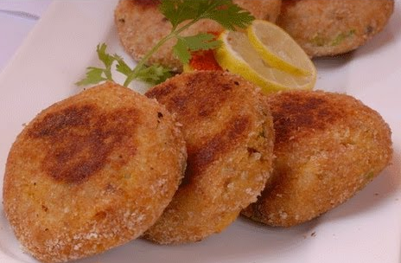
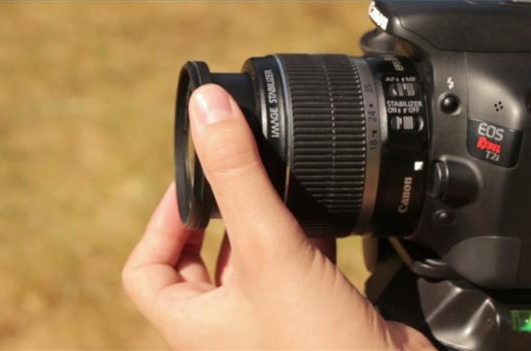
Vocabulary
A thick slice of fish typically cooked by frying.
The art or process of taking photographs.
Photography
On
Meaning
Off
Fish cutlet
On
Meaning
Off
She likes photography.
Fish cutlet is vey tasty.

Slide 12
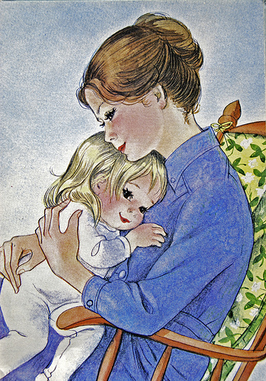

Vocabulary
like (something or someone) very much.
produce flowers; be in flower.
Bloom
On
Meaning
Off
Adore
On
Meaning
Off
The rose is blooming.
Mother adores her child .

Slide 13
Now listen to a dialogue between them. Then act out the dialogue in pairs. The dialogue is given in section B, in the text book.
Dialogue
Dialogue
Notes:
The students will listen the dialogue . Then the teacher can ask the students to practice the dialogue with their friends for 5 minutes. The dialogue is given in section B, in the text book. 3/4 pairs can be asked to act the dialogue. Teacher can appreciate them and correct their mistakes mildly.

Slide 14
Individual Work
Go to the textbook and read the passage from section A and write the answer of the following questions.
1 When does Kobita like listening to music?
Answer
She likes listening to music in her free time.
2. Why does Kobita’s father hate pop music?
Answer
He hates pop music because they don’t appeal to emotions.
3. What does Kobita love watching?
Answer
Kobita loves watching full bloom flowers of her garden.
3. What does Kobita adore?
Answer
Kobita adores the flowers that she grows.
Notes:
The teacher can ask SS to go to the textbook , section C and read the passage. After reading the passage student will find out the answer from the passage. 10 minutes can be given for the task. Then the teacher can elicit answer from 4/5 students. Then teacher can show the answers.

Slide 15
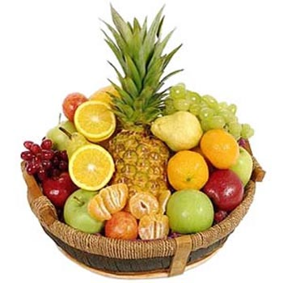
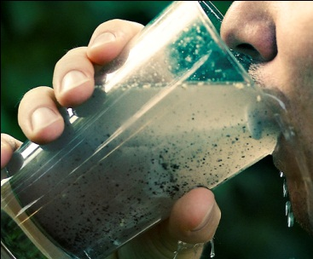

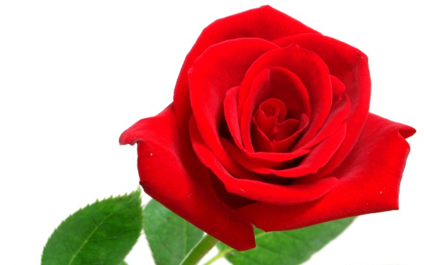
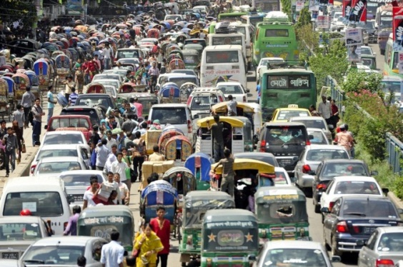

Individual Work
Look at the pictures. Now make five sentences about what you adore, love, like, don’t like and hate.
Notes:
The students can make sentences orally or write sentences. The teacher will elicit answer from 4/5 students.

Slide 16
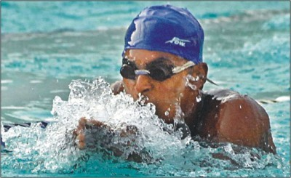
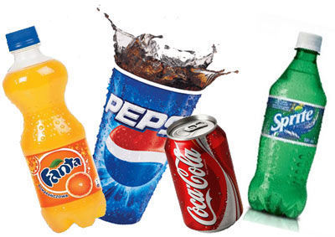
Pair Work
Look at the pictures and the answers. Can you make questions for the answers?
Question:
Do you like swimming?
Answer: Yes, I like swimming.
Question:
Do you like soft drinks?
Answer: No, I don’t like soft drinks.
Notes:
Students can make questions orally. Then Teacher will show the questions.

Slide 17
Pair Work
Make questions for the answers.
Question:
Do you like travelling?
Answer: Yes, I like travelling.
Question:
Do they like wasting time ?
Answer: No, they don’t like wasting time.
Question:
Does she like flowers?
Answer: Yes, she likes flowers.
Question:
Does he like junk food?
Answer: No, he doesn’t like junk food.
Notes:
Students can write the questions. Teacher will elicit the task. Then Teacher will show the questions.

Slide 18
Home work
Ask one of your family members about his/her likes and dislikes. Write five likes and five dislikes of his/her.( 10 lines)

Slide 19
Acknowledgement
MoE, DSHE, NCTB & A2I respective of officials
And the editors panel: Ranjit Poddar, Associate Professor (English) TTC, Dhaka, Md. Jahangir Hasan (English), Assistant Professor TTC, Rangpur and Urmila Khaled Assistant Professor (English) TTC, Dhaka.
Their direction, valuable suggestions and intensive supervision have enriched the model contents.

Slide 20
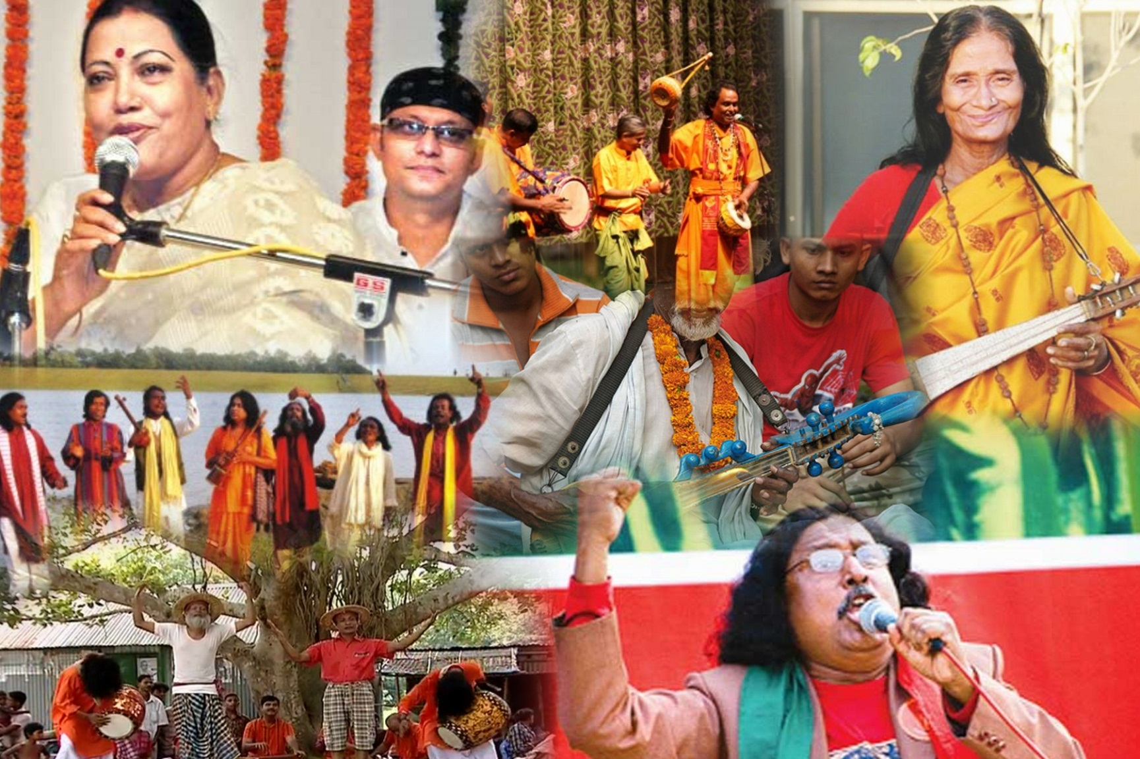
Love our beautiful folk songs and uphold them to the world.
Thank you all.

